Slide 1
“Navigating Tomorrow: Utilizing PUNS for Future Planning”
Presented by:
Ruth Aguilar
Senior Ligas Family Advocate
The Arc of Illinois
The Ligas Family Advocate program is funded by the Department of Human Services

Slide 2
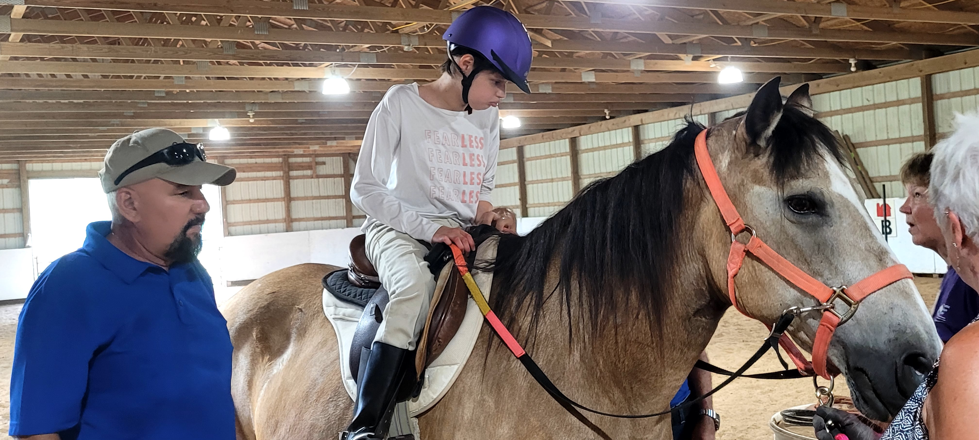
Meet Ruth
Mom to Valerie (ID/DD)
Qualified Intellectual Disabilities Professional
Bilingual, former ISC, SDA
15+ years of combined experience in the ID/D Community

Slide 3
Today’s Goals
Understand PUNS database
Learn how to connect with your Independent Service Coordination Agency (ISC)
Begin preparation for services and supports
Be introduced to the programs of the Social Security Administration available for people with disabilities: SSI & SSDI.
Learn eligibility requirements for these programs and how to apply.
Be introduced to Illinois Medicaid programs of All Kids, AABD & ACA
Learn eligibility requirements for these programs and how to apply.
Be introduced to the programs of The Arc of Illinois and how these programs help families, self-advocates and professionals in Illinois.

Slide 4
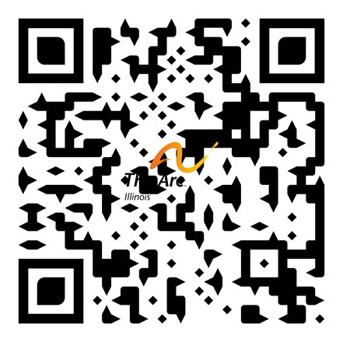
Programs of The Arc of Illinois
Illinois Lifespan – Information & Resources
Family to Family Health Information Center
Family Support Network of Illinois
Ligas Family Advocate Program
Family Transition Project
Consumer Stipend Program
Assistive Technology Program
Training Department
www.thearcofil.org

Slide 5
Developmental Disability System – Illinois Basics
Illinois Department of Human Services
Division of Developmental Disabilities (DDD)
Home-based Supports Program (HBS)
Community Integrated Living Arrangement (CILA)
Division of Rehabilitation (DRS)
Home Services Program

Slide 6
Division of Developmental Disabilities (DDD) Waivers
Adult Waiver
Children’s Support Waiver
Residential and home-based services
Up to 25,859 adults
18+ years old
Home Based Services
Up to 1,440 youth and young adults
3 up to 22nd birthday

Slide 7
Illinois Medicaid Waivers
The state receives approval to operate a waiver from the Federal Center for Medicaid & Medicare Services (CMS). The waiver abides by federal Medicaid regulations (i.e. conflict free case management, Settings Rule).
9 waivers
Department of Human Services
Division of Developmental Disability
Oversees 3 of the 9 waivers
Children and Young Adults with Developmental Disabilities – Supports Waiver
Children and Young Adults with Developmental Disabilities – Residential Waiver (HCBW – DDD)
People who are Medically Fragile, Technology Dependent Waiver (MFTD – DSCC)
Persons with Disabilities (DRS)
Persons with Brain Injuries
Adults with Developmental Disabilities
Persons who are Elderly
Persons with HIV or AIDS
Supportive Living Program

Slide 8
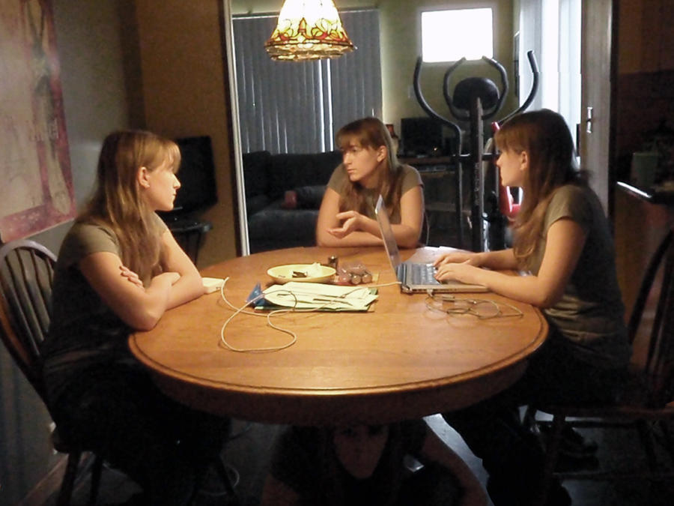
Start with key questions:
Who is part of my child’s support system?
Do you expect that support system to remain stable and engaged into adulthood?
If not, how do you bolster that support?
What are my child’s preferences?
Do they prefer activity, engagement, social time, or do they value more quiet environments?
How does your child make decisions? What support is needed?
What type of support is needed in daily activities?
Does your child have chronic medical needs that require support into adulthood?
What are your child’s goals/hopes around employment and independent living for the future?
This Photo by Unknown Author is licensed under CC BY-NC-ND

Slide 9
PUNS: What is it?
Statewide database that registers children & adults who want or need the Developmental Disability Home and Community Based Waiver
Funded by the Illinois Department of Human Services, Division of Developmental Disabilities
As funding is available, individuals are selected from PUNS and invited to apply for waiver services.
PUNS is not an acronym – it does not prioritize based on urgency of need.

Slide 10
PUNS Categories – Seeking & Planning
Seeking
Currently want or need services
PUNS selections are only made from this category, as funding is available (typically once a year).
Time on the PUNS list begins accumulating toward selection only in this category.
Planning
Do not currently want or need supports,but may in the future.
For individuals who are not currently seeking services will be needing services if something happens (i.e. caregiver becomes ill).
Time spent in the ‘planning’ category does not move an individual closer to funding.

Slide 11
When should an individual with I/DD place their name on the PUNS list?
As soon as possible
The ‘wait time’ for services does not start until the age of 18, only in the Seeking Services category
Before 18, allows the state to plan for the needs of individuals who will qualify for supports in the future
Contact your Independent Service Coordination agency to be placed on the PUNS list
Recently, individuals were selected for the Children’s waiver; they were in the Seeking Services category.

Slide 12
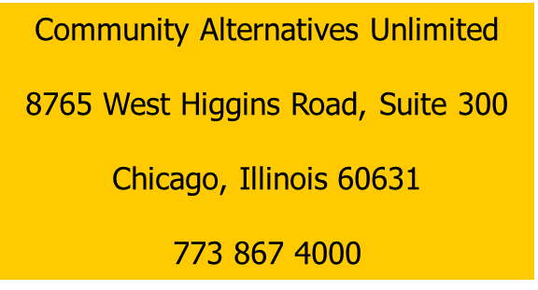
Enrolling on PUNS
Contact your ISC agency
Your ISC is your gateway to services. Your ISC is the starting point for receiving services through state funding.
Call Division of Developmental Disabilities Hotline at 1-888-DD-PLANS and 1-866-376-8446 (TTY) during business hours. When prompted by the recording, type in your ZIP Code and you will find your local ISC agency.
Access the DHS Office Locator.
Service, Inc. of Illinois
Region E
1919 South Highland Avenue
Building A, Suite 230
Lombard, IL. 60148
Main Number (630) 425-2350

Slide 13
Preparing for a PUNS selection
Apply for, and maintain, Medicaid.
Keep school & evaluation records in order and accessible (make copies!).
Maintain accurate and up-to-date medical records.
Identify and contact your Independent Service Coordination Agency
Become familiar with Developmental Disability Provider agencies.
Be prepared to apply for Medicaid and SSI at adulthood.
Transition planning is key!
Consider the need for, and all options around, guardianship.
Explore supports and services before you need them.
This Photo by Unknown Author is licensed under CC BY-NC-ND

Slide 14
How long will I wait for supports?
Children/Adults must be in the Seeking Services category to accumulate time towards the PUNS selection.
Time spent on PUNS, while under the age of 18, does not count towards selection.
Currently, wait time for new individuals on PUNS (age 18 and over) who want or need services is about 5 or more years, on average.
The Division of Developmental Disabilities has committed to having no adult wait more than 5 years/60 months by July 2024.
Want to find out when your or your loved one might be selected from PUNS?
Email name and birthday to DHS.DDD.PUNS@illinois.gov
Estimate timeframe will be provided
(i.e. Summer 2026)

Slide 15
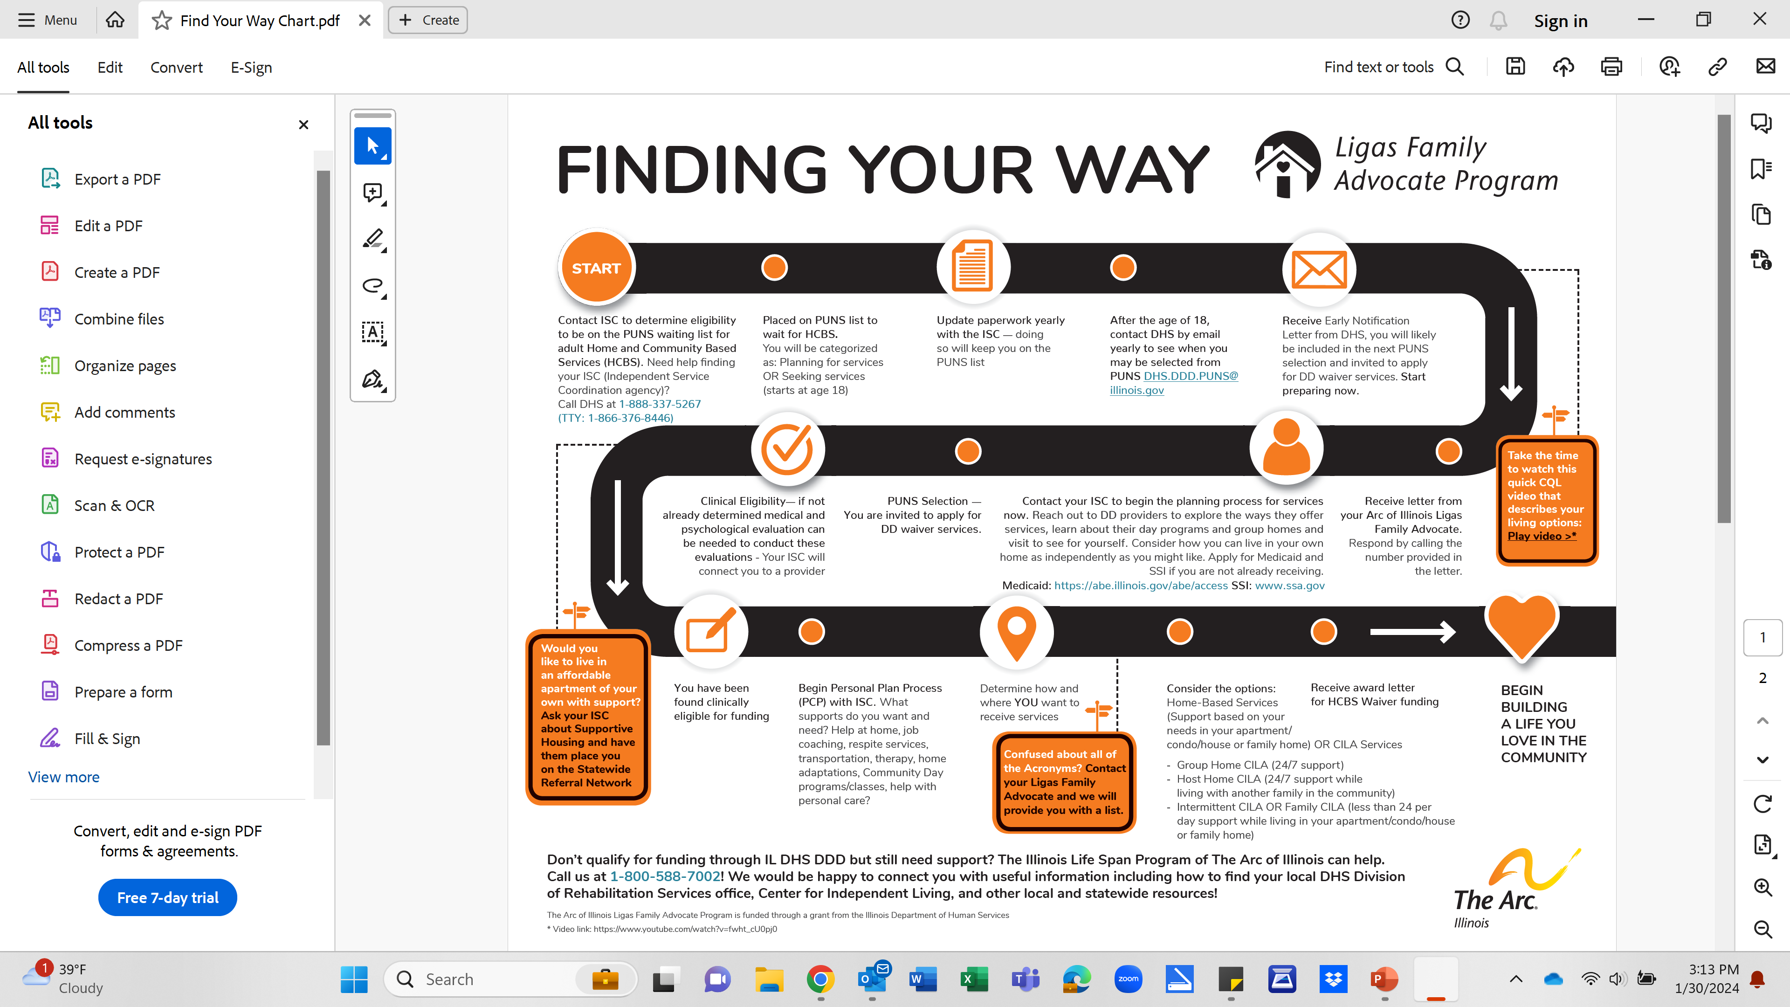

Slide 16
Long-term supports; can switch between programs if not meeting your needs.
Adult Home Based Services
Funding is fixed
3 times SSI ($943.00 in 2024 = $2829.00 total)
All services/supports must fit within monthly budget
Personal Support Worker (PSW)
Community Day Services program
Self Direction Assistance (SDA)
Optional service ($54.59)/hour
Assistance in arranging for, directing & managing PSW services, recruiting & hiring of PSWs
CILA
(Community Integrated Living Arrangement)
No fixed funding amount
Group Home (24/7 care, up to 8 housemates)
Host Home (24/7 care, up to 2 housemates)
Intermittent/Hourly CILA (less than 24/7 care daily)
Your own apartment (can be supportive housing)
13

Slide 17
Children’s Home Base Services
Monthly Based on calendar year
Annual budget based on 2x SSI per month (Currently $22,632)
Flexible Spending (Up to 4x SSI in a month)
Budget 2x SSI $943x2 = 1886

Slide 18
I was pulled off PUNS… now what?
Maintain close contact with your ISC; they are your gateway to services.
Work together to apply for services
Contact the Ligas Family Advocate program
Free, unbiased consultation and guidance
Attend webinars
Learn about, and decide upon, services
Apply for & maintain Medicaid eligibility
Gather paperwork, evaluations, and forms in an easily accessible file.
Reach out to me!

Slide 19
Questions?
Ruth Aguilar,
Senior Ligas Family Advocate
The Arc of Illinois
ruth@thearcofil.org
815-464-1832

